Slide 1
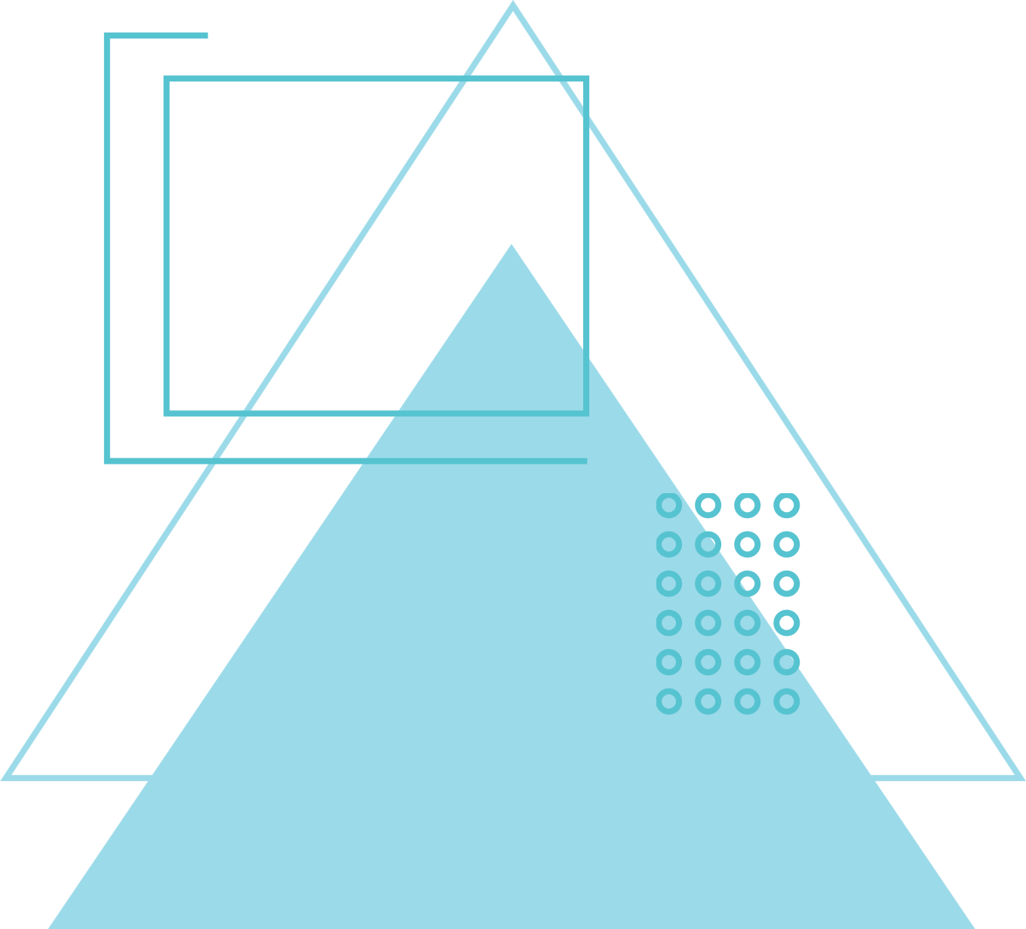
Phase 2
Project: Java and Web Development
By Aashish Choudhary
https://github.com/aashish090/IU_DLBCSPJWD01-Trackify
1

Slide 2
Purpose of the Application
A simple web app for users to track their daily tasks and build productive habits. Users can create accounts, manage to-dos and recurring routines, and receive email reminders. The app offers an intuitive interface to monitor progress and stay consistent with personal goals.
2

Slide 3
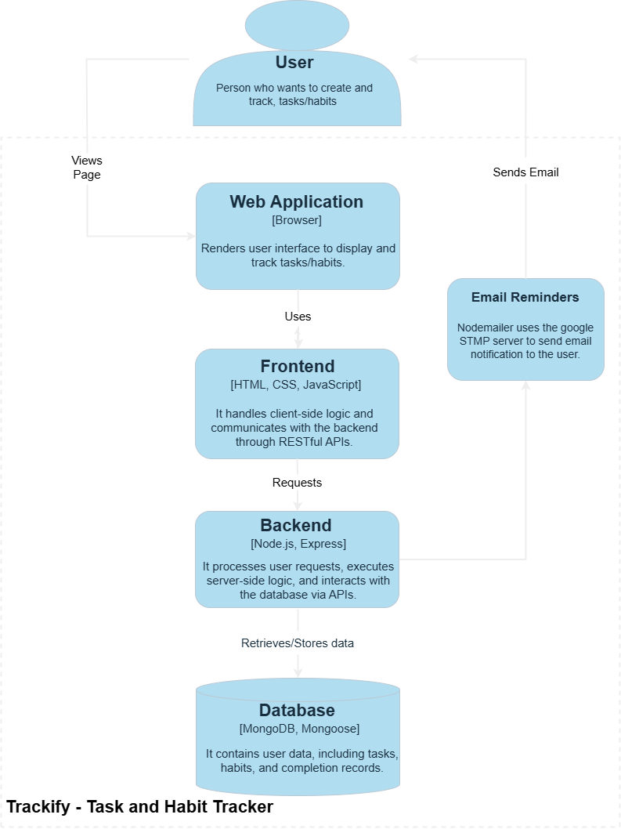
Container Architectural Diagram
3

Slide 4
Tech Stack
Frontend
Backend
Database
HTML5 – Structure and markup of the web pages
CSS3 – Styling and layout for a responsive UI
Vanilla JavaScript – Core functionality and interactivity
Node.js – JavaScript runtime environment for server-side logic.
Express.js – Lightweight framework for routing and middleware
MongoDB Atlas – Cloud-based NoSQL database for storing users, tasks, and habits
Mongoose – ODM for modeling MongoDB data in JavaScript
4

Slide 5
Use Cases
Task Scheduling & Tracking: Users can create tasks with deadlines and mark them complete to stay on top of priorities.
Daily Habit Building: Helps users form consistent routines by setting daily habits with streak tracking.
Automated Email Reminders: Sends timely notifications 1 hour before tasks or habits — boosting accountability.
Secure User Authentication Users can register/login securely using hashed passwords (bcryptjs).
Reminder Control & Preferences: Toggle email reminders ON/OFF anytime from the dashboard.
5

Slide 6
SCREENSHOTS
5

Slide 7
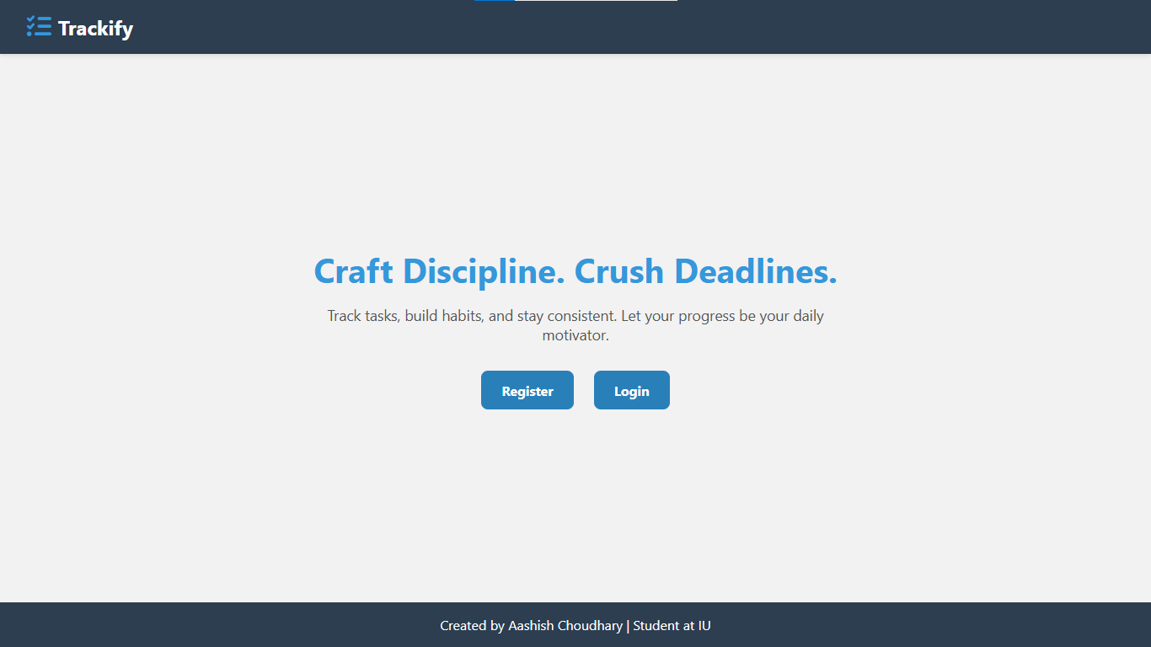
Call to action buttons
6

Slide 8
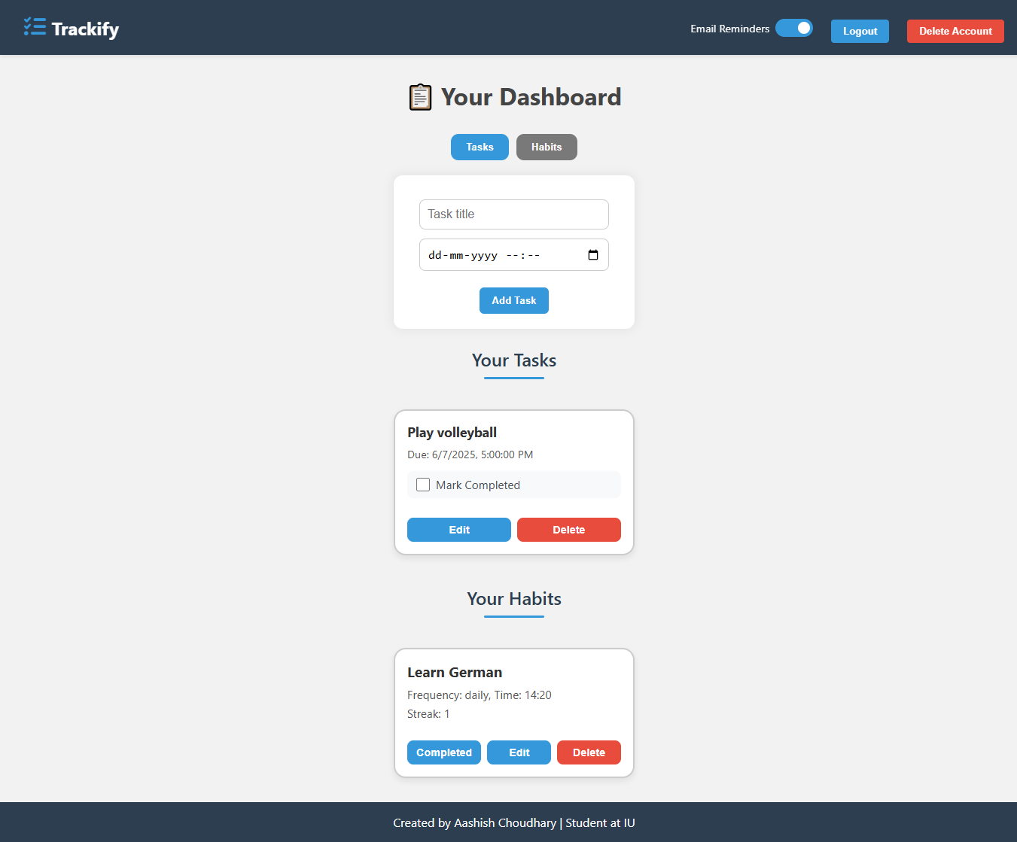
Toggle buttons to create task or habit
Toggle button for email reminder
Task List
Habit List
7

Slide 9
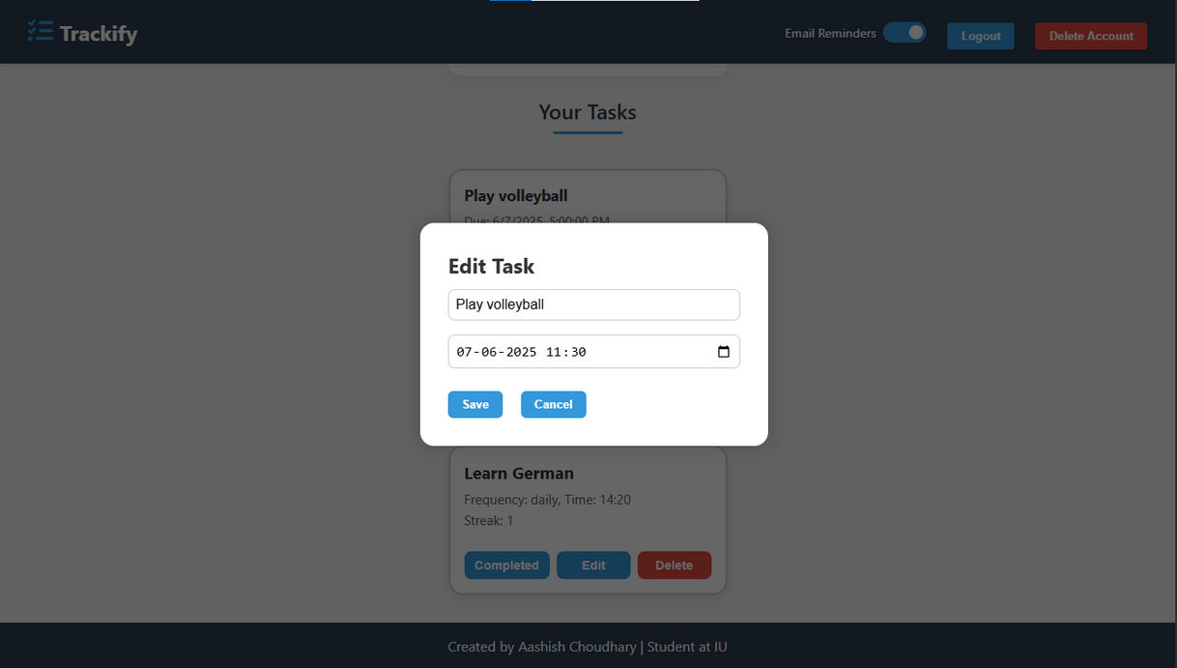
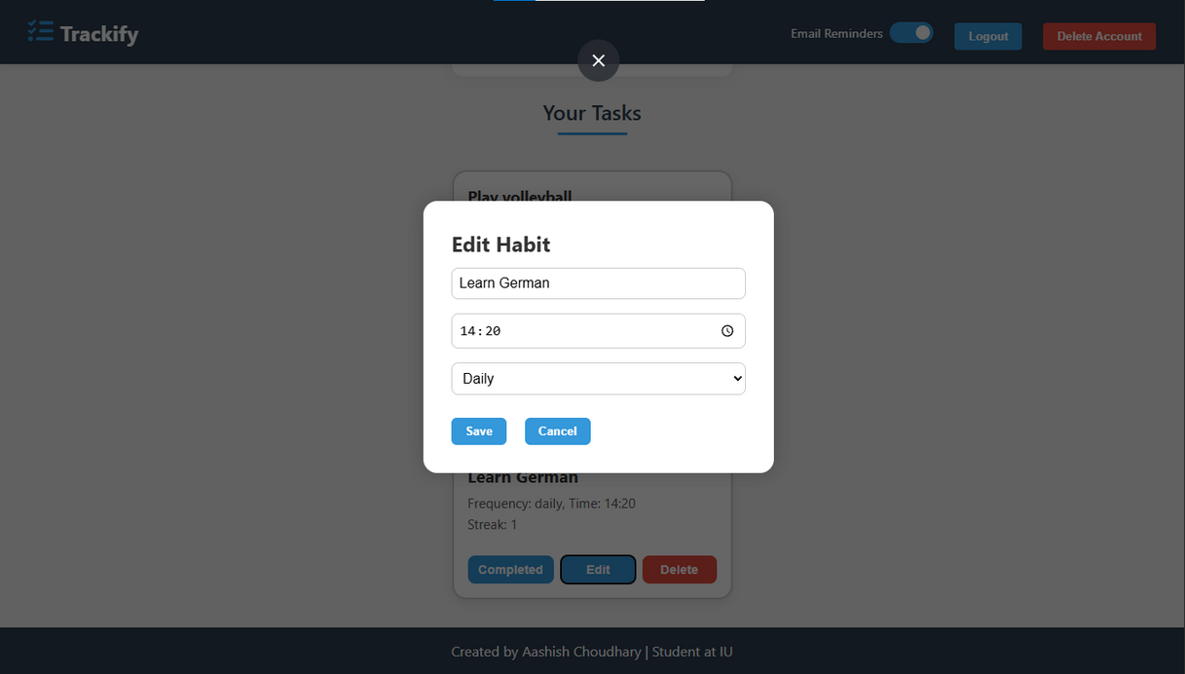
Modal to edit tasks and habits
8

Slide 10
Changes to my proposal
After reviewing my initial proposal, I decided to keep the original design unchanged. The chosen technologies—HTML, CSS, JavaScript for front-end, Node.js with Express for the back-end and MongoDB Atlas with mongoose for the database. I am comfortable with this tech stack as I did a course on web development focusing on this tech stack, allowing me to develop the application more efficiently.
Moreover, I did not receive any feedback suggesting changes, and my initial choices effectively meet the requirements, there was no need for adjustments. However, I remain open to refining the application based on future feedback.
9

Slide 11
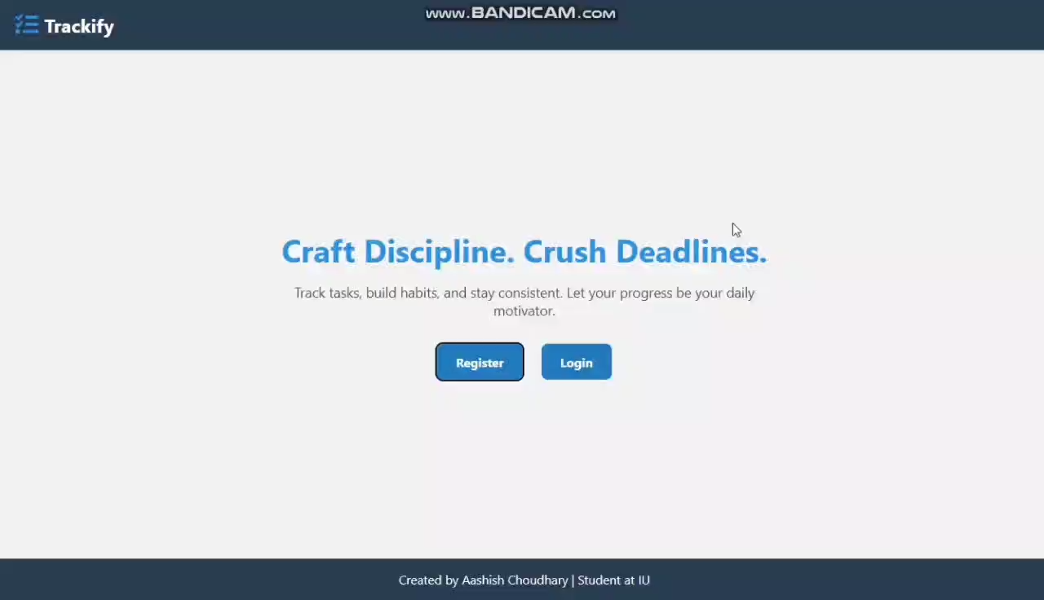
10

Slide 12
THANK YOU
By Aashish Choudhary
https://github.com/aashish090/IU_DLBCSPJWD01-Trackify
11

